Slide 1

Session 14 (of 24)
PGR112 Objektorientert programmering
Yuan Lin / yuan.lin@kristiania.no

Slide 2
Today’s Main Goal
A Recap of Optional
Validation
Java life cycle & Garbage collector
Lambda expression
Some Small Picks
Var
Method reference
More about Exception handling
High cohesion, low coupling

Slide 3
Status
Step 1: IntelliJ, Git, Hello World
Step 2: Variable, Method, Data type, Scope, Control statement
Step 3: Class, Object, Scanner, Encapsulation
Step 4: Package, Import, Modifiers, Overload, ArrayList, Enums
Step 5: Scanner (cont.), Input validation, Debugger, Write test
Step 6: Exception handling, File I/O, Logger, Date/Time
Step 7: Inheritance, Aggregation, Super, Final
Step 8: Abstract
Step 9: Interface
Step 10: Polymorphism
Step 11: Collection, Optional, Equals, HashCode, Serialization, Validation…
…
Step 14: Validation, Java life cycle, Garbage collection, some small picks

Slide 4
Optional
Creating Optional objects
Optional.empty()
Optional.of()
Optional.ofNullable()
Check Optional value presence
Optional.isEmpty()
Optional.isPresent()
Optional.ifPresent() + orElse() /orElseGet()
Return Optional value
Optional.get()
Optional.filter()

Slide 5
Clean code with Validating input
Sometimes, we want to ensure that input to the method is acceptable so that the method can perform what is is supposed to.
It is not always sufficient to only know the types of arguments.
What should we do if the input is not satisfactory or unacceptable?
Throw an exception? (e.g., IllegalArgumentException)
Return a default value? (if the method is not void)
Early quit the method? (if the method is void)

Slide 6
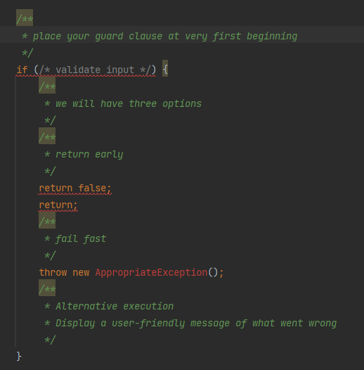
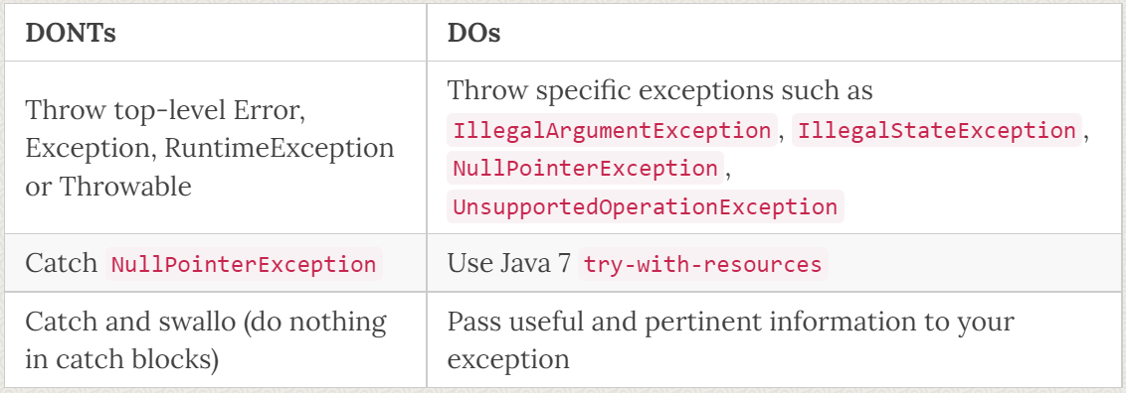
Validating input – Guard clause
Guard clause – Fail fast & Return early
Validating method inputs:
Validating null (and/or string is empty)
Validating a condition
Comparison order
Rules
Put guard clause at the very first beginning of the code
Preventing propagation of invalid values
Choosing right exceptions
https://ducmanhphan.github.io/2019-12-22-Clean-code-with-validate-input/

Slide 7
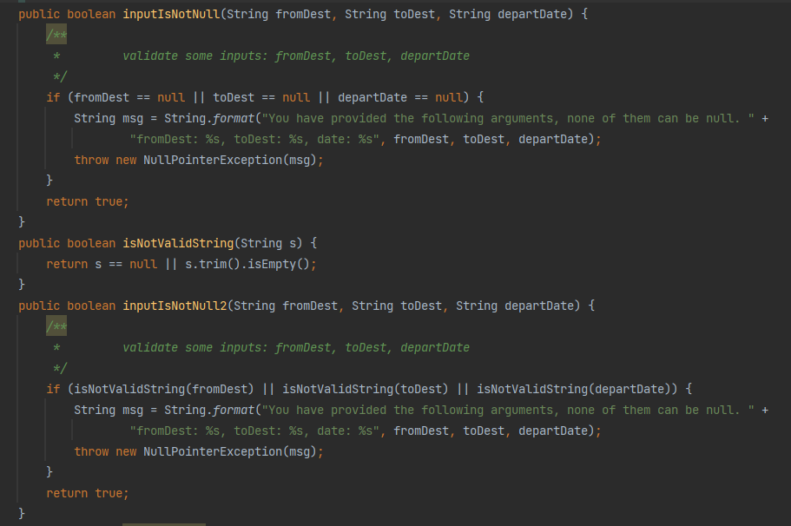
Validating input – demo
Validating null (and/or string is empty)

Slide 8
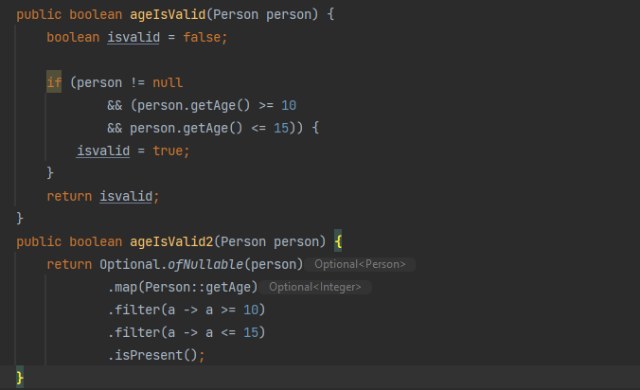
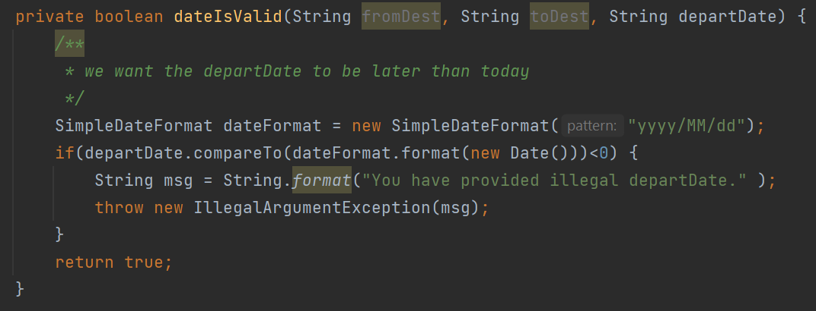
Validating input – demo
Validating a condition

Slide 9
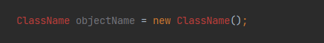
Understanding Object Life Cycle
JVM allocates memory to create an object
Objects are created by the new keyword
JVM allocates the necessary memory in the Heap Area to create an object
Once this memory is allocated, it holds the reference to this memory through some variable objectName
Java memory Structure
All object instances and arrays are stored in a heap area
The reference variables of objects are stored in JVM Stack.
Any object is alive as long as there are some references to i. As long as there are no references to it, the object dies and known as garbage.

Slide 10
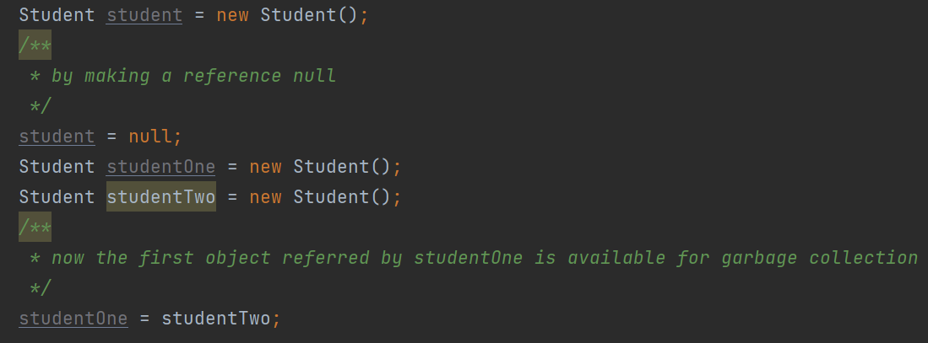
Garbage Collection
What is Garbage Collection in Java?
The main objective of Garbage Collection is to free heap memory by destroying the objects that don’t contain a reference.
There are various ways of releasing reference to an object to make it a candidate for Garbage Collection
By making a reference null
By assigning a reference to another
Object created inside a method will also make object eligible for garbage collection
Note that the object can not become a candidate for garbage collection until all references to it are discarded.

Slide 11
Garbage Collector
Before Java 9, the Object class has a finalize() method, which is automatically called by GC before it attempts to remove the object from the heap.
System.gc() + @Override finalize() is a standard way of explicitly perform garbage collection.
Since Java 9, finalize() has been deprecated due to many reasons, i.e., leading to performance issues, deadlocks, and hangs…
Java.lang.ref.Cleaner provides more flexible and efficient ways to release resources. Whe an object becomes unreachable.
Suggest reading: https://medium.com/javarevisited/time-to-say-goodbye-to-the-finalize-method-in-java-a2f5b7e4f1b1

Slide 12
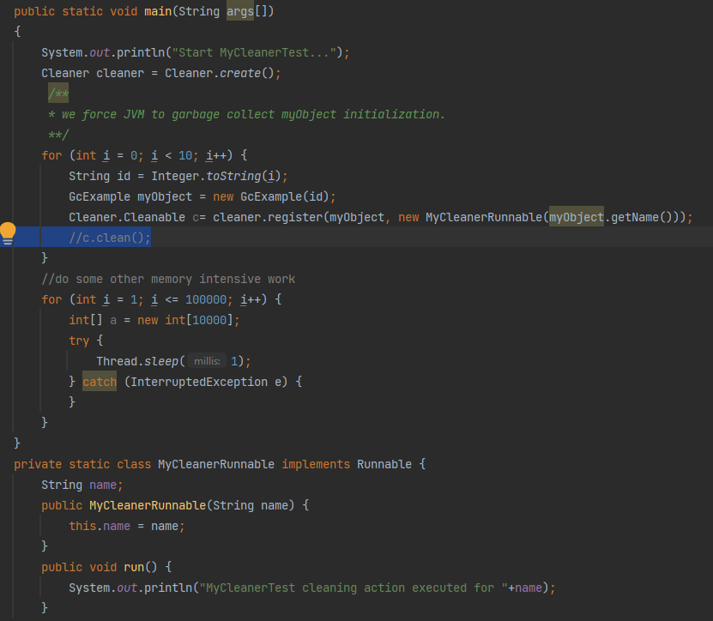
How to use the Cleaner class?
Create the instance of Cleaner
Register a cleaning action for the object
The returned Cleanable object can be used to invoke the cleaning runnable action forcefully even before object is due for garbage collection. We can use clean() for it.
We can also do some memory intensive work to force JVM to perform garbage collection in order to release memory.

Slide 13
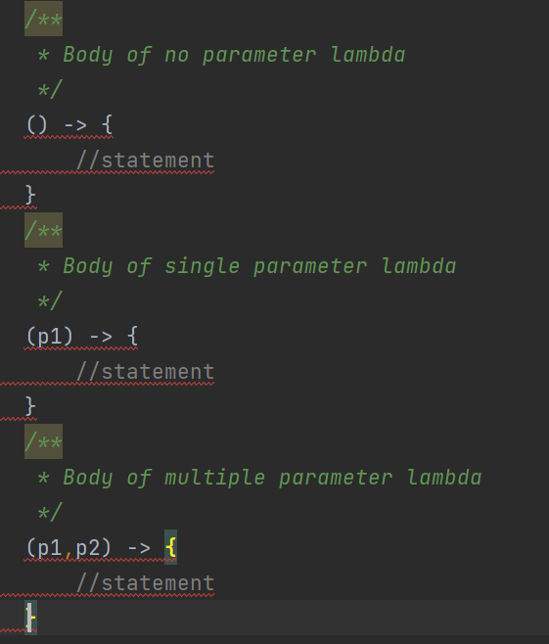
Lambda expression
Lambda expression is a new and important feature that is included in Java SE 8.
When there is a functional interface concept used, we can use lambda expression. We don’t need to define the method for providing the implementation. We just write implementation code.
Java Lambda syntax: (argument-list) -> {body}
1)Argument-list: It can be empty or non-empty
2) Arrow-token: it is used to link arguments-list and body of expression
3) Body: It contains expressions and statements

Slide 14
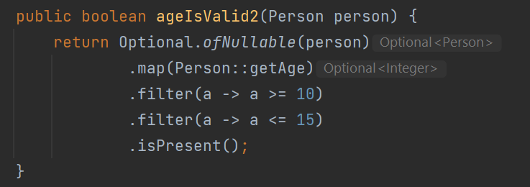
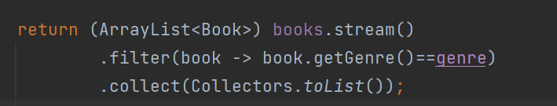
Lambda expression
We have used lambda expressions before…
Why use Lambda expression?
To provide the implementation of functional interface
Less coding
When do we usually use Lambda expression?
It is very useful in collection. It helps to iterate, filter, map and extract data from collection
It can be used to sort and compare
It can be used to create thread..

Slide 15
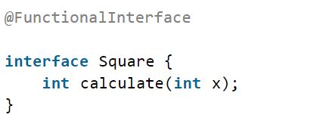
Lambda expression
What is functional interface?
A functional interface is a interface that contains only one abstract method
There are many interfaces that are converted into functional interface since Java SE 1.8. All of these are annotated with @FunctionalInterface.
Runnable: this interface only contains the run() method
Comparable: this interface only contains the compareTo() method
ActionListener: this interface only contains the actionPerformed() method
Callable: this interface only contains the call() method
We can define our own functional interface

Slide 16
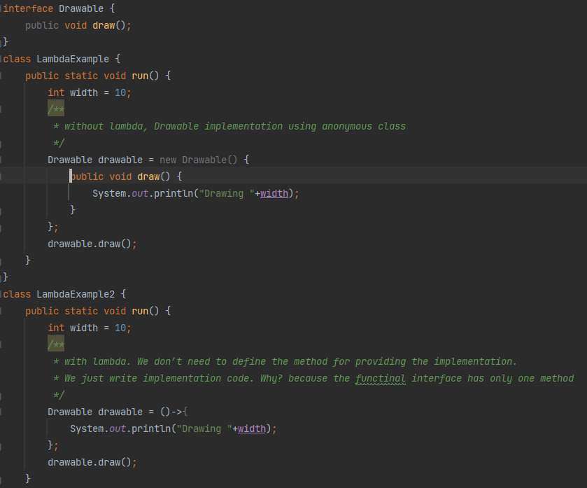
Lambda expression
Our first lambda expression…
Drawable is a functional interface
LambdaExample implements the method without using lambda expressions
LambdaExample2 implements the method with lambda expressions.

Slide 17
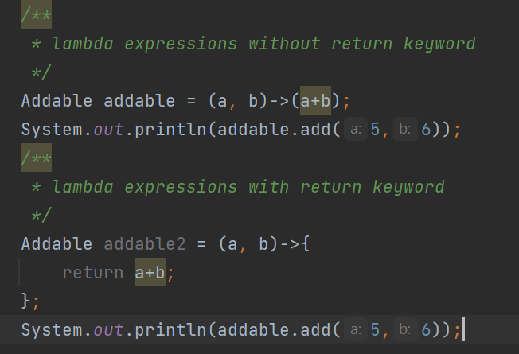
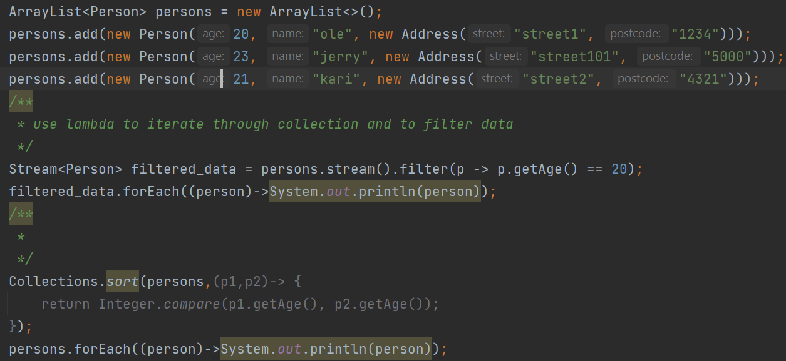
Lambda expression
Lambda expression can be with and without return keyword.
Lambda expression: forEach.

Slide 18
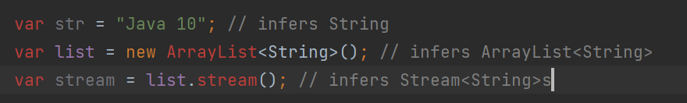
var
From Java 10 we have var
We can use var instead of specifying the type when we declare a variable
For local variable declaration (in methods)
Only if we instantiate it in the same line
The compiler understands what type of variable to have (provided immediate initialization)

Slide 19
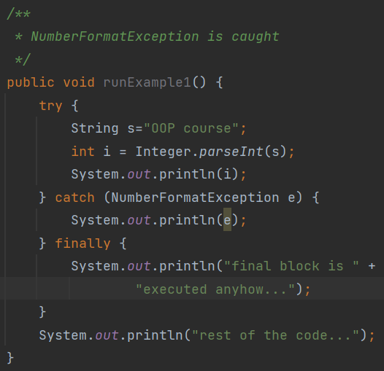
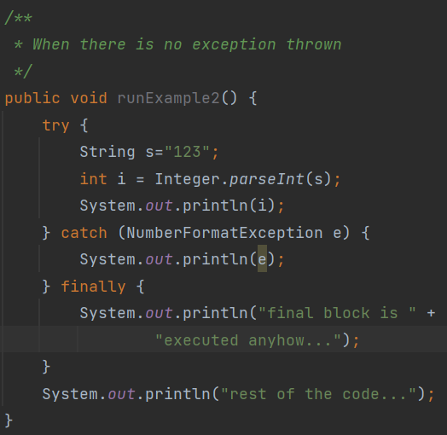
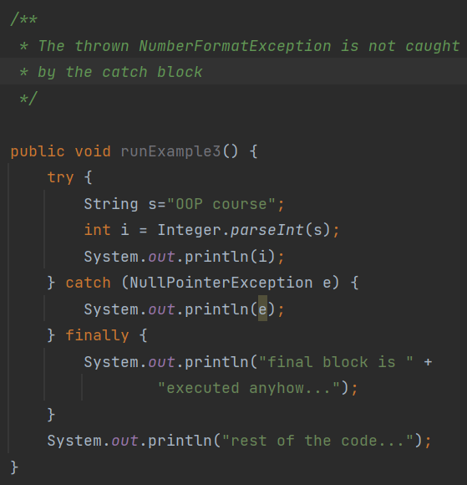
More about Exception handling
Remember try/catch/finally?
In addition to try/catch, we can have a finally block that runs after catch.
Finally block will be executed in any circumstances as shown below
We usually put cleaningup code in finally block

Slide 20
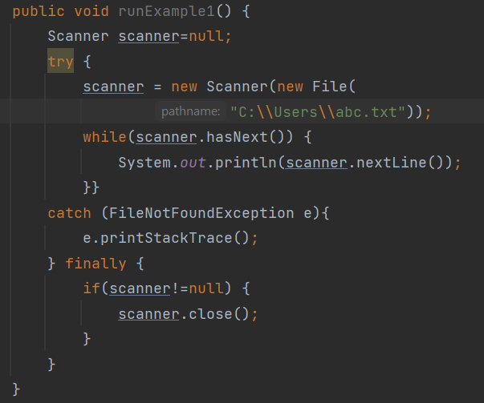
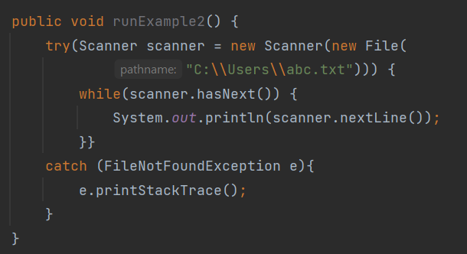
Try-with-resources
Replacing try-catch-finally with try-with-resources
We can declare one or more resources
With try-catch-finally clause, you use finally block to ensure that a resource is closed
With try-with-resources, resource is closed automatically

Slide 21
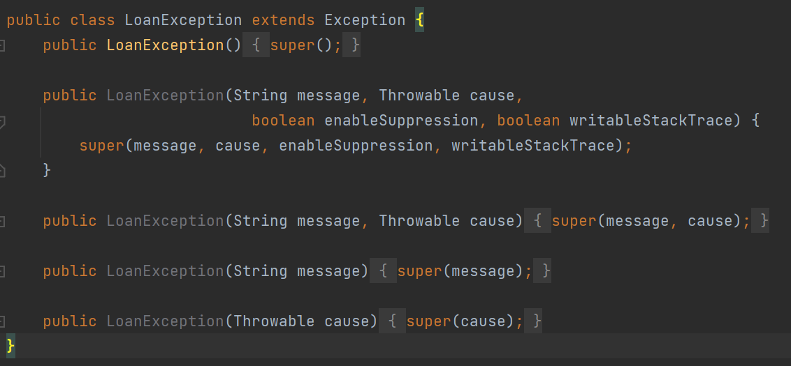
Custom exceptions
If we do not find an appropriately available exception in the Java library, then we can create our own.
All custom exceptions inherit from Exception class.
You should do following:
Find out which exception you want to extend (inherit from), checked or unchecked?
Create constructors which harmonize with the constructors in the super class
Be sure to call your class <descriptive name>Exception

Slide 22
Method reference
Java 8 provides a new feature called method reference. It is used to refer method of functional interface.
If you are using lambda expression to just referring to a method, you can replace lambda expression with method reference.
Types of method references
Reference to a static method. Syntax is ClassName::MethodName
Reference to an instance method. Syntax is InstanceName::MethodName
There are many interfaces that are converted into functional interface since Java SE 1.8. For example,
list.forEach(item->System.out.println(item))
can be converted to
list.forEach(System.out::println)

Slide 23
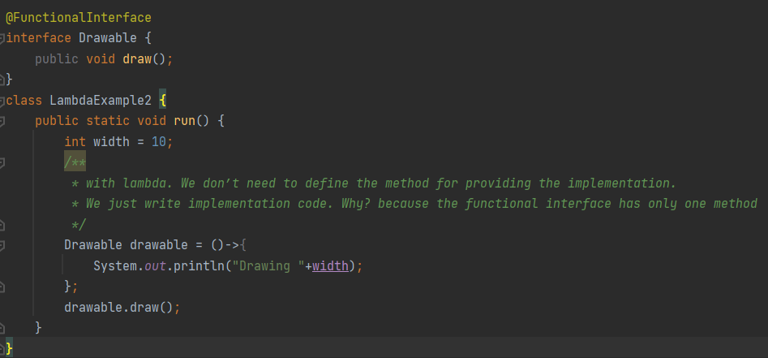
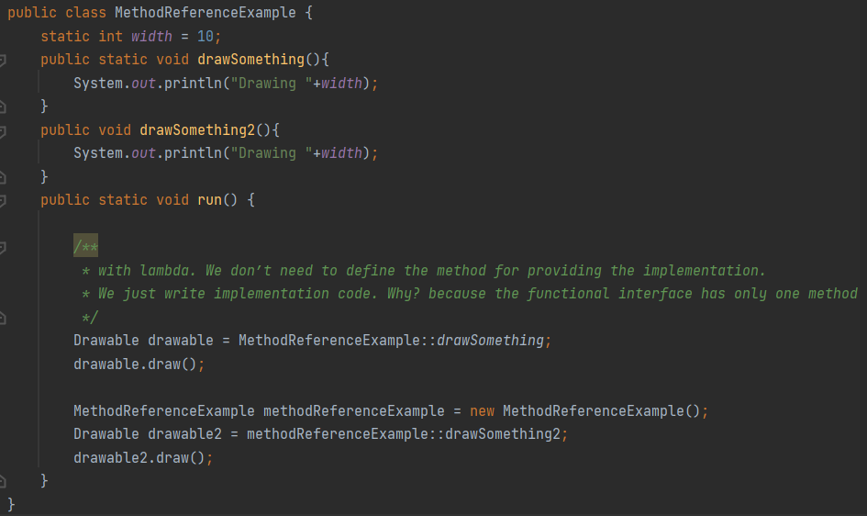
Method reference
Example on the right shows lambda and method reference
Drawable is a functional interface
We can replace lambda expressions with method references.
We illustrate both static and instance method references.

Slide 24
High cohesion – low coupling
Cohesion: the degree to which a part of a code base forms a logically single, atomic unit.
A class should have only one area of responsibility (Single responsibility principle)
A method should perform “one thing”, not “many things”
Encapsulation
Coupling: the degree to which a single unit is independent from others
Inheritance vs aggregation
Dependence on classes(implementations) vs interface (abstraction)

Slide 25
Before we end
Goals for this session:
I have a deeper understanding of Optional
I know how to validate input
I know object life cycle and garbage collection
I know how to use Lambda Expression
I know how to use method references
Remember, do not just read code, play with it. Good luck with the tasks! Remember, there is help available all week, use Mattermost or GitHub.

